Slide 1
Checking Your Monthly Schedule on Web Amion

Slide 2
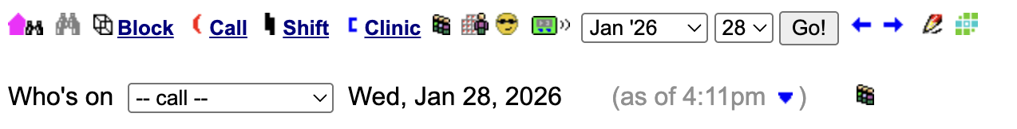
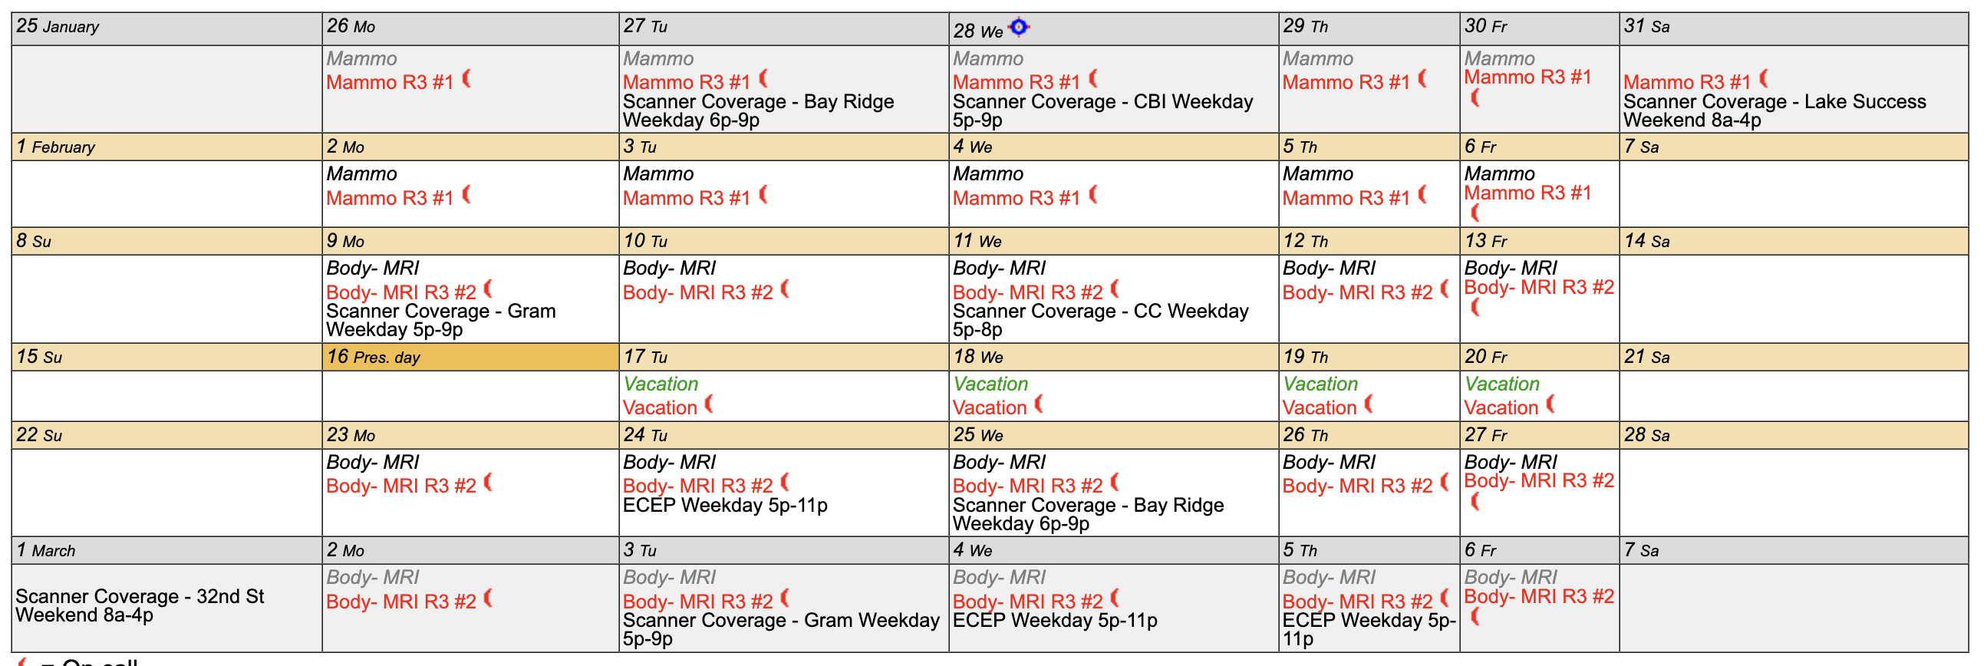
Residency Shifts (for Residents)
Look at the radiology residency schedule using access code “radhs”
Default should be the binocular page (see binocular grayed out on first image)
If you find your name and click on it, should show your monthly schedule including your residency contrast shifts (see second image)

Slide 3
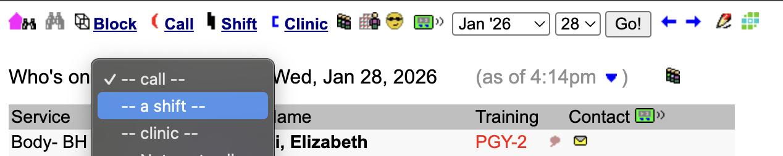
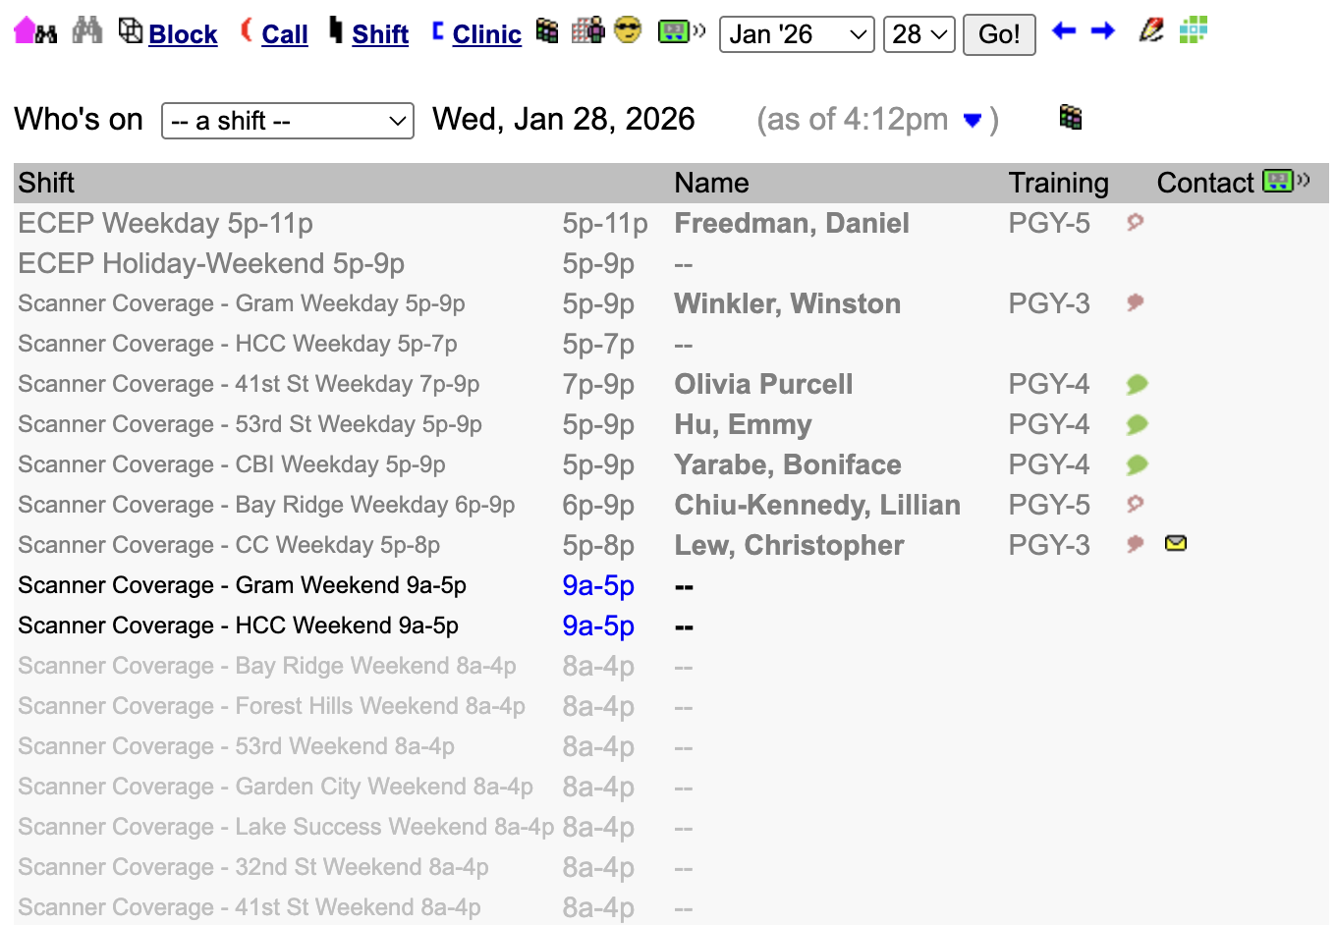
Residency Shifts (for Fellows)
If you’re a fellow and you’re checking your coverage for residency shifts (eg. Bay Ridge, CC), you won’t find your name on the default page because you’re not on any residency rotations
You can choose the “shift” option on the drop down (see first pic), which will show residency contrast shift assignments for the day (second pic)
Go to a day you covered contrast, find your name, and then you can also check your monthly schedule

Slide 4
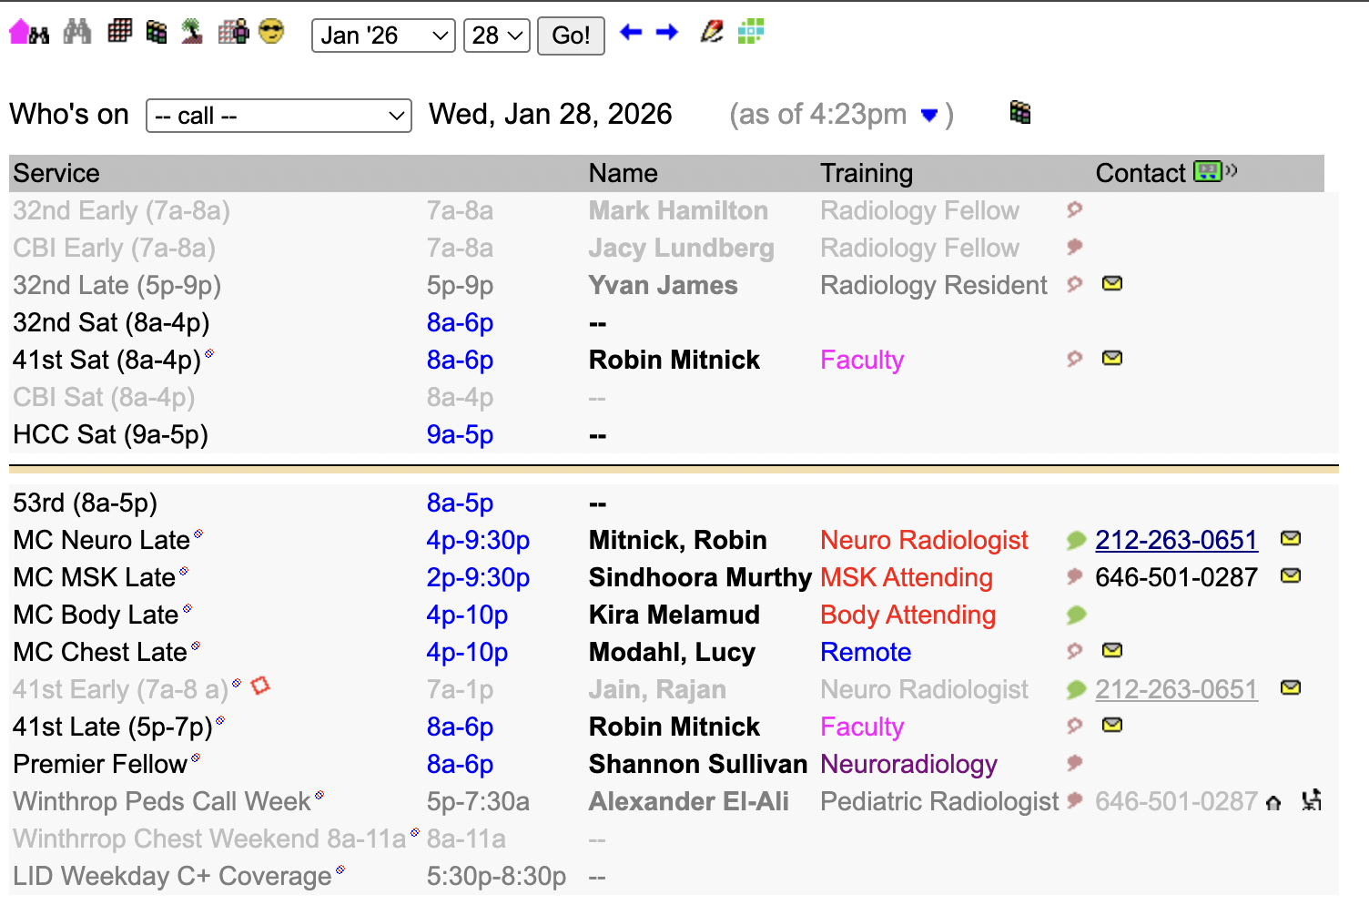
Fellow Shifts
These cover CBI/32nd 7 AM shifts, 32nd street late 5-9 PM shifts, and FPO (HCC) weekend shifts
Use access code “nyu contrast” to get to the schedule that includes these
Find and click your name on a day you covered a shift
You can check your monthly schedule

Slide 5
Checking Your Monthly Schedule on Phone App Amion

Slide 6
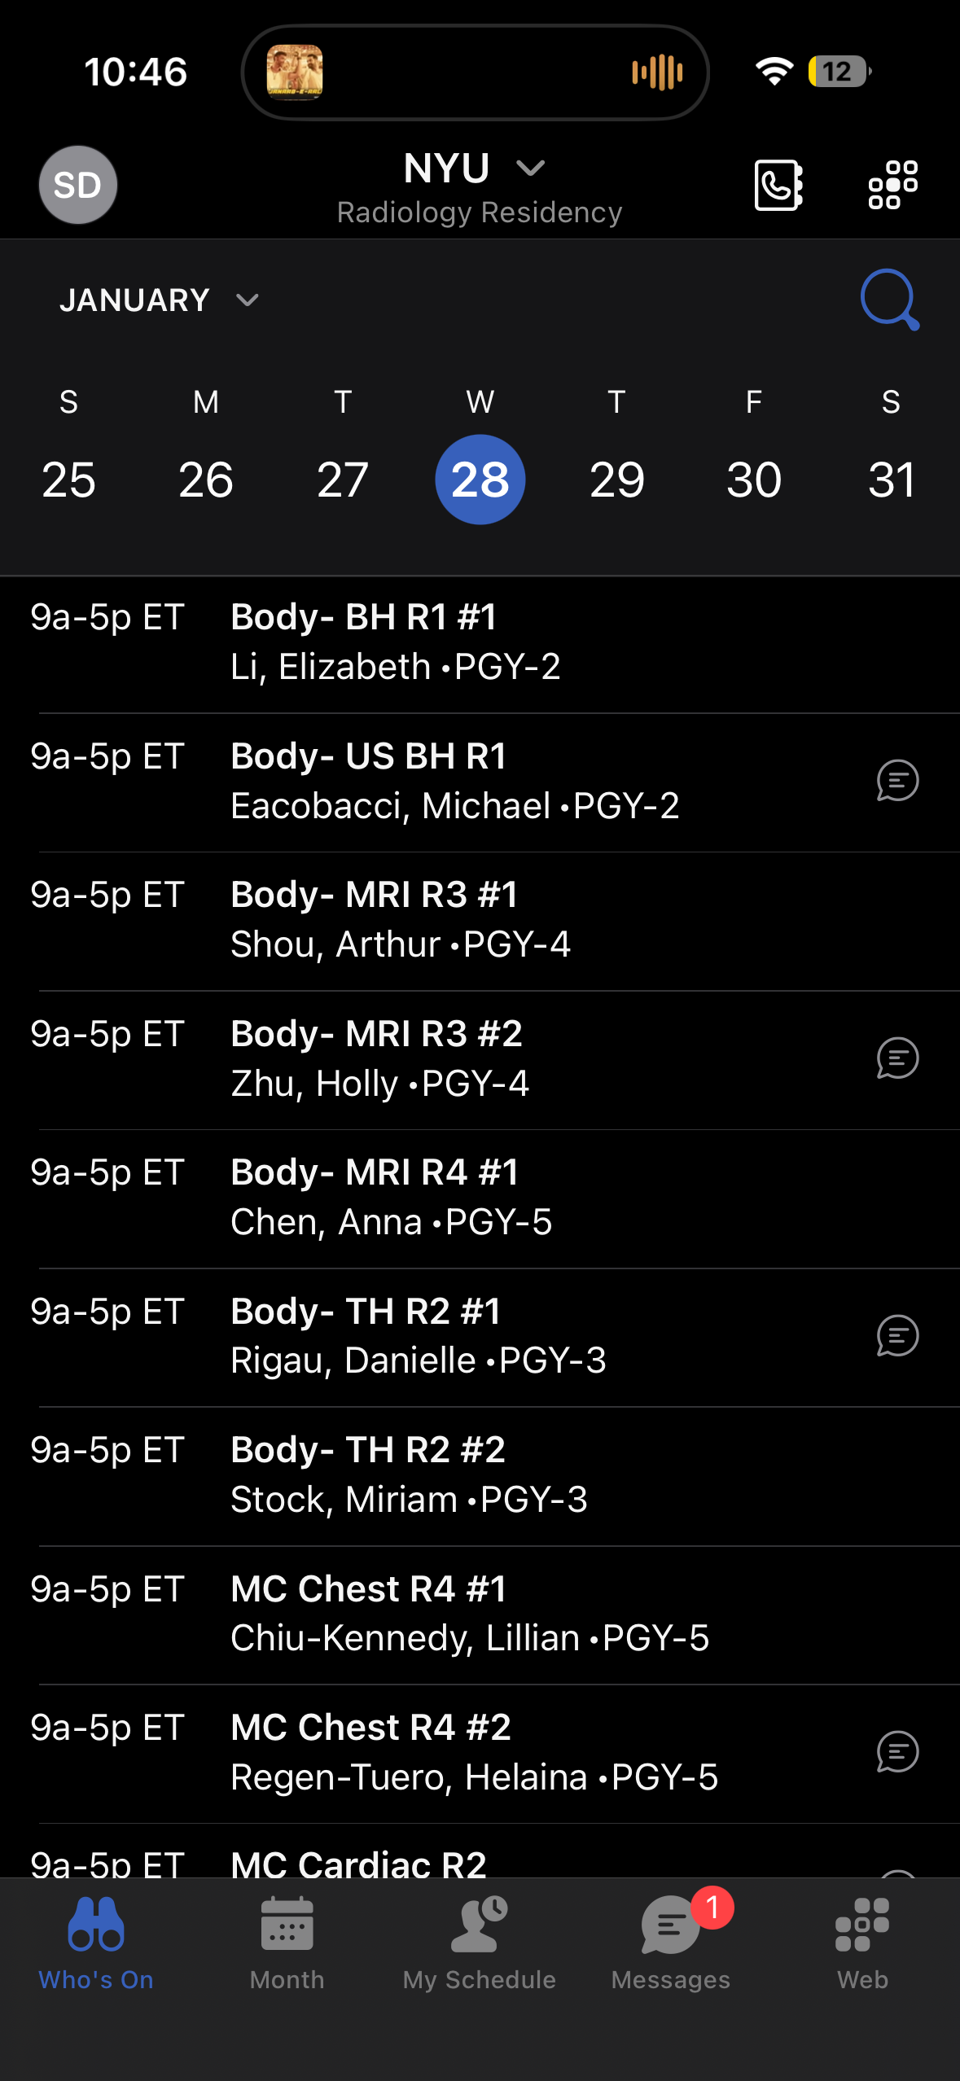
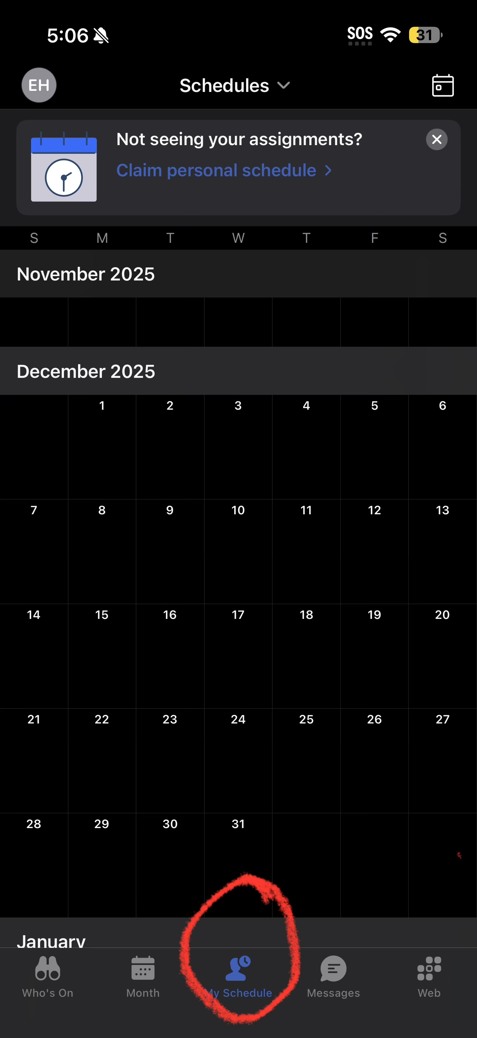
Add Schedules
If you haven’t configured this before, you must add your schedule
Go to your profile on the top left and click add schedule
You can add Radiology Residency (for resident shifts) and Radiology – Contrast Coverage (for fellow shifts)
Use the same access codes as on prior slides
On the icon bar at the bottom, go to “My Schedule”
At the top, click the “Schedules” drop down

Slide 7
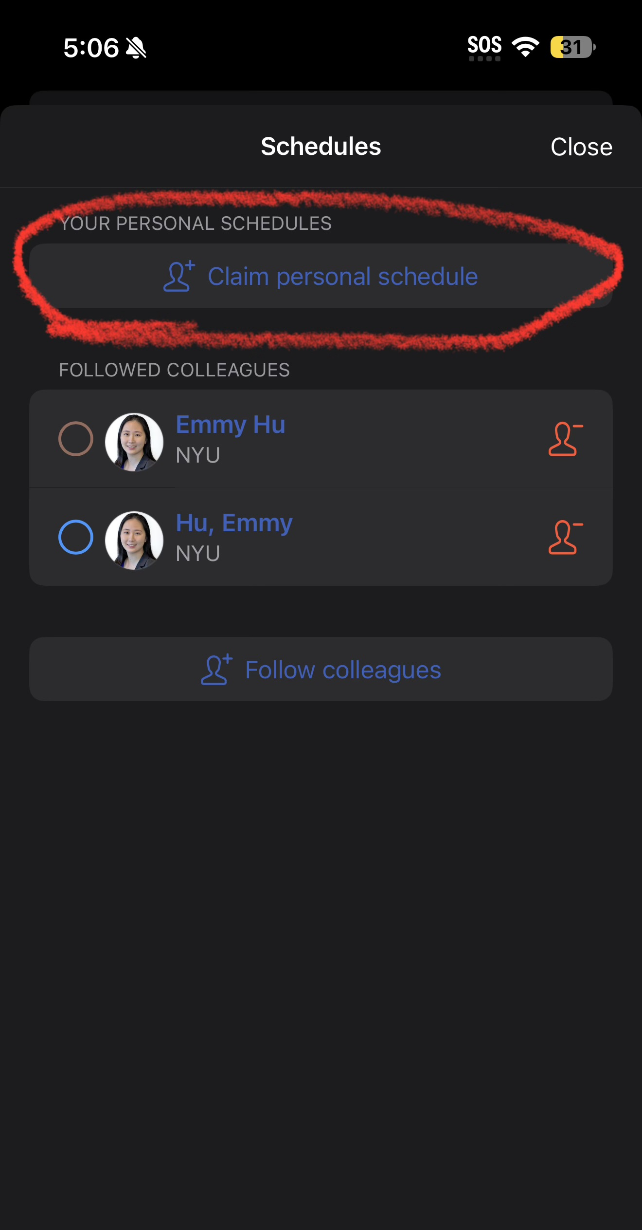
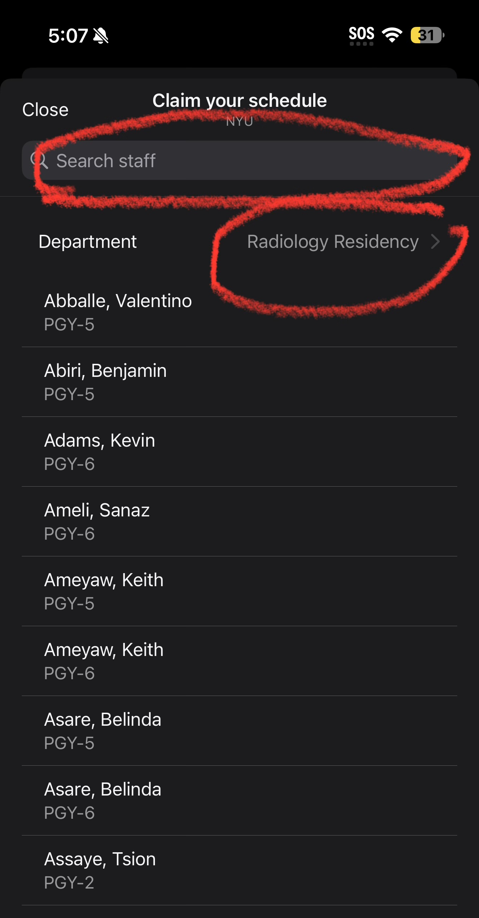
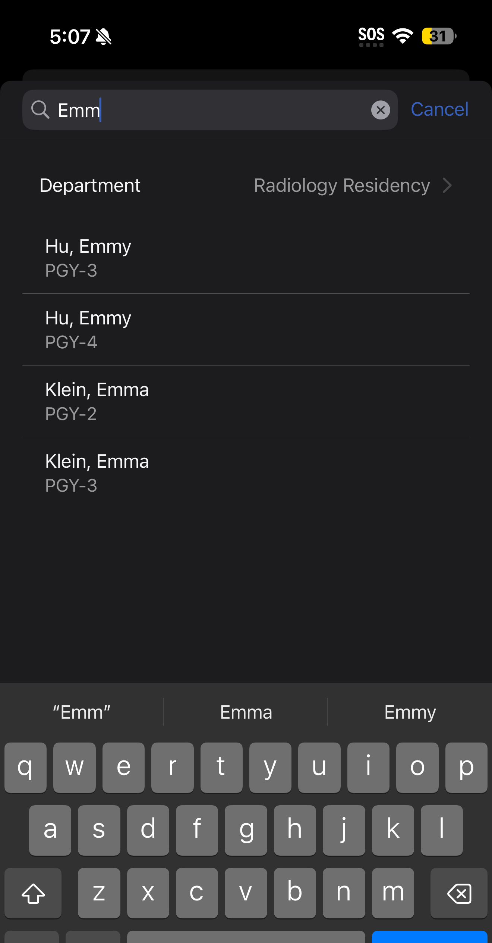
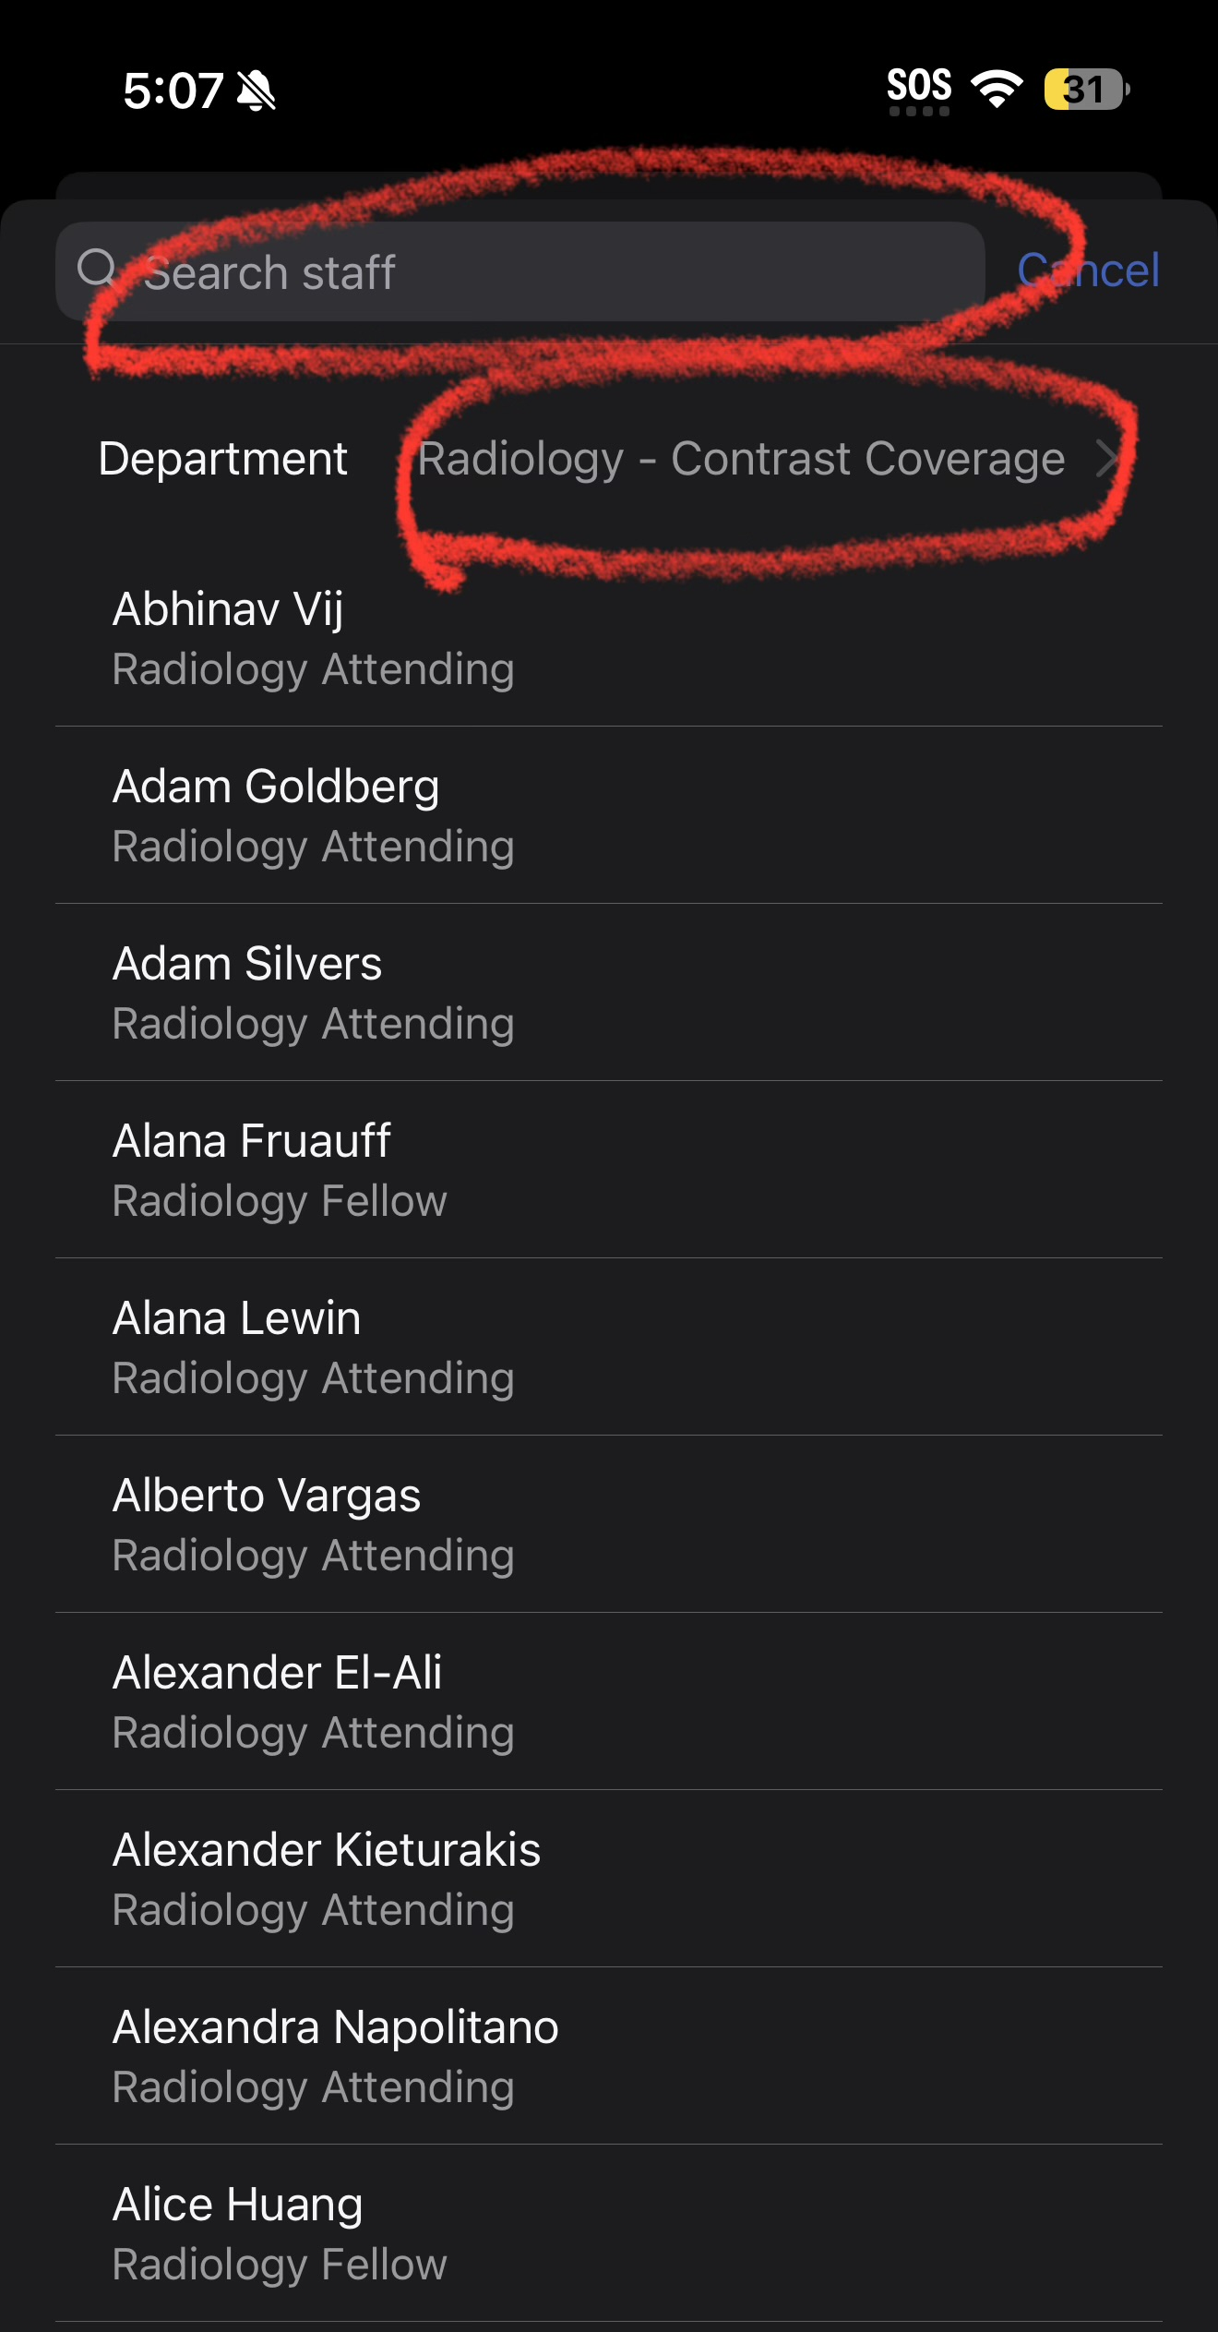
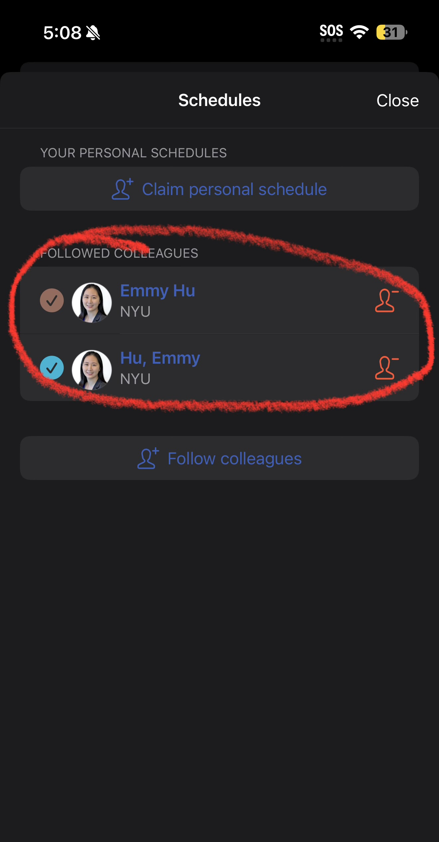
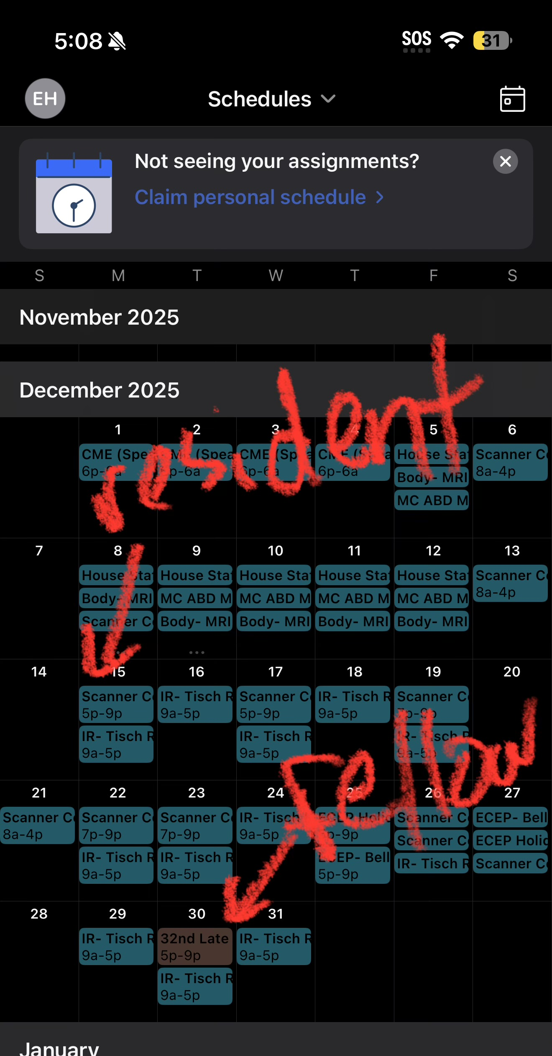
Claim Your Schedule
Click ”Claim personal schedule,” select Radiology Residency and Radiology - Contrast Coverage schedules, and search your name
If you haven’t done a fellow shift, you won’t find yourself in Radiology – Contrast Coverage, but then this shouldn’t apply to you anyway
You should now be able to see your schedule for the month
(Thanks Emmy for the screenshots!)

